Slide 1
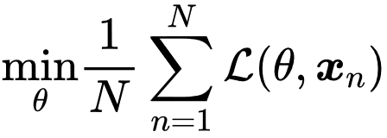
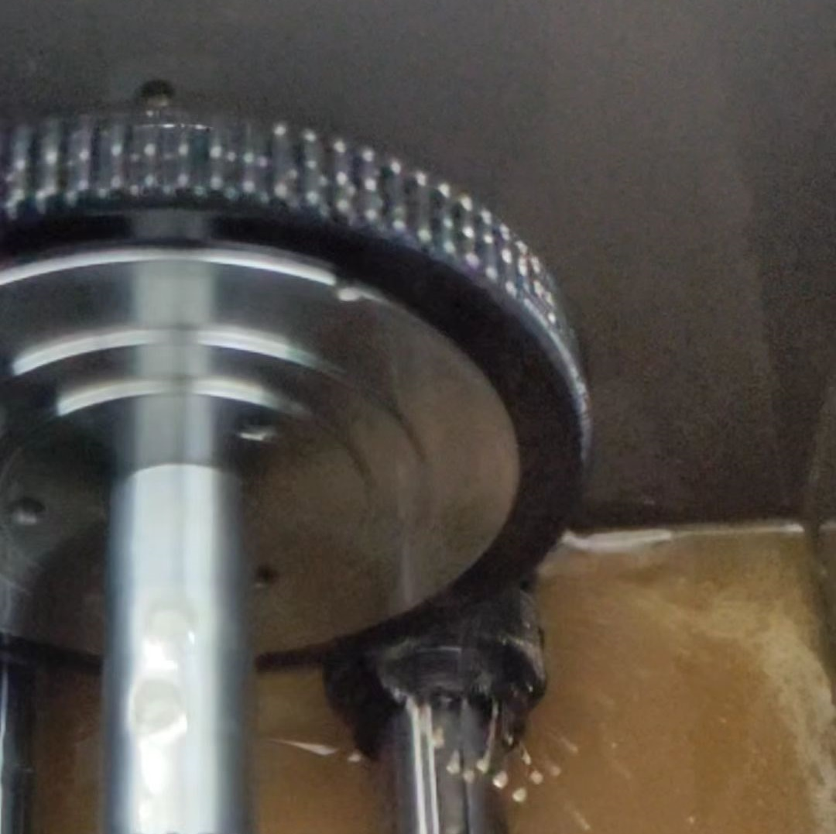
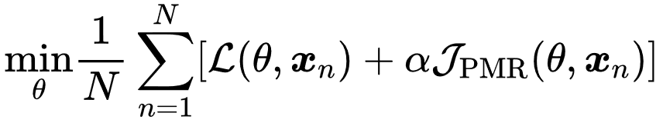

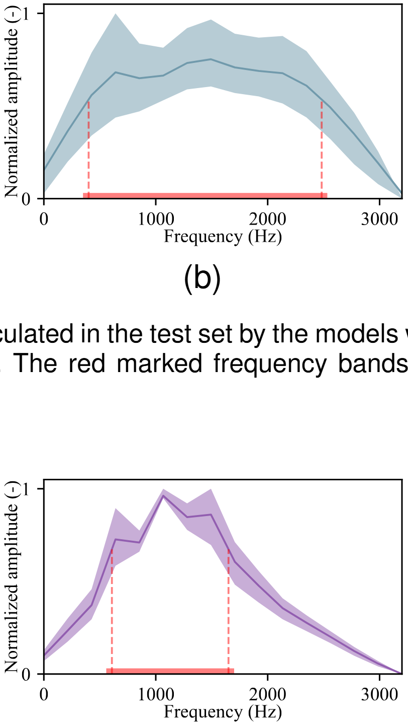
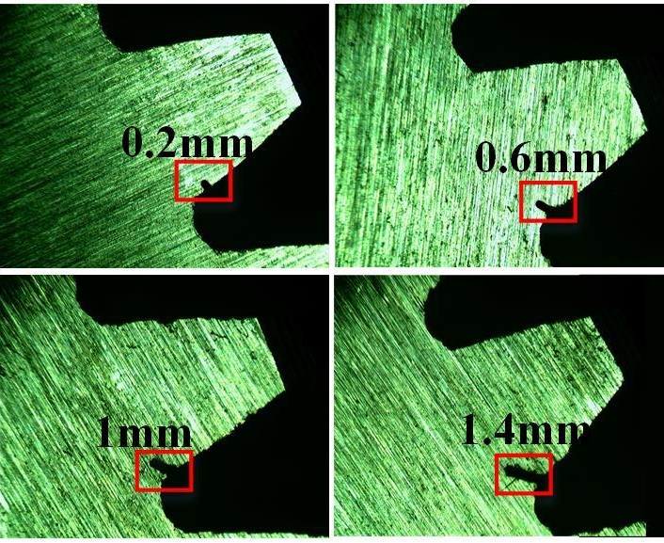









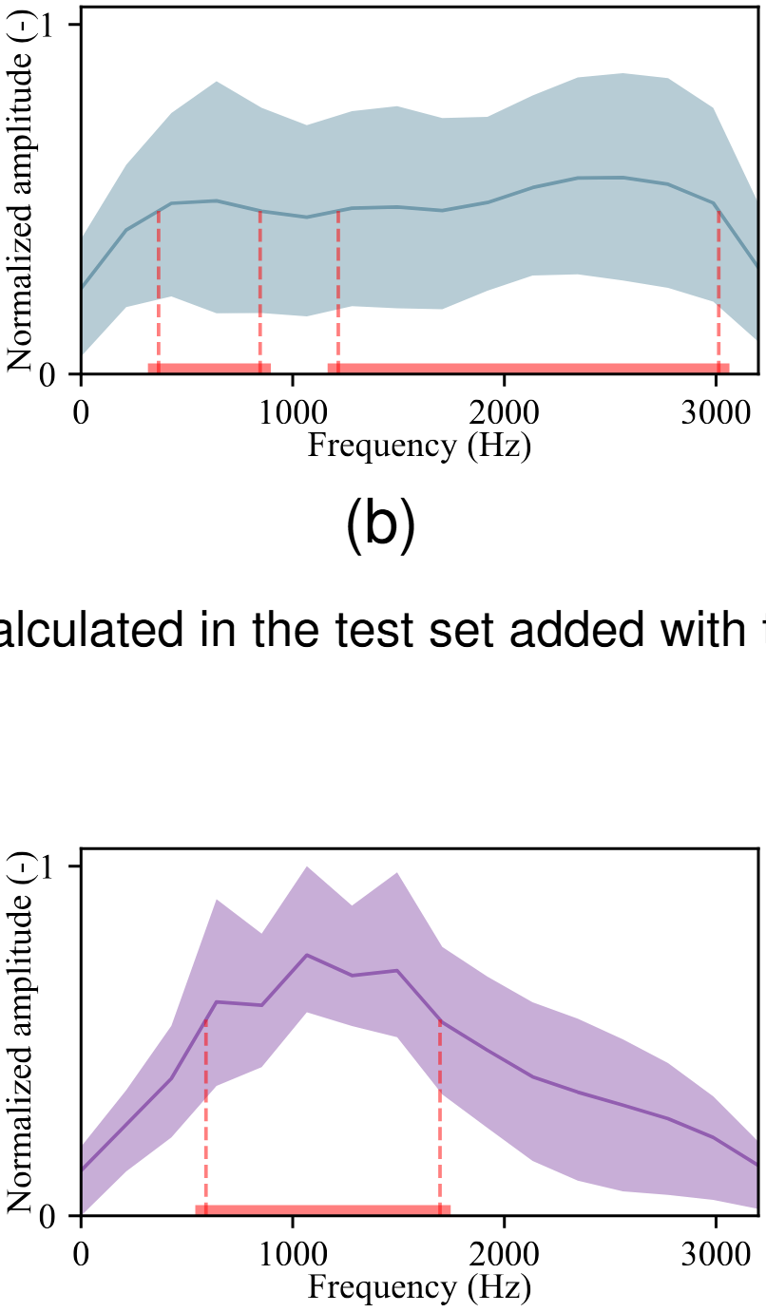

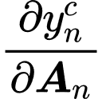



Workflow
Data preparation
Diagnostic models
Model test
UM-GearEccDataset with 11 FSLs of eccentricity fault.
Without PMR, the optimization object is:
Obtain the test accuracy of the test set without added with additional noise.
Obtain the test accuracy of the test set added with additional noise.
l_{e}
With PMR, the optimization object is:
Do saliency analysis to get the saliency weight (CAM results) to know which parts of the input spectra the models focus on.
First-step Backward Propagation
Second-step Backward Propagation
Without PMR
With PMR
XJTUSpurgear dataset with 5 FSLs of root crack fault.
Forward Propagation
x_{n}|_{n=1,2,…,N}
Original test set
Focused area
/Σ
…
…
CNN
Classifier
Softmax
Distracted by noise
Still focused
|_{n=1,2,…,N}
Noised
test set
J_{PMR}
Training set
Trained models
Test set

